Slide 1
Chapter 3. Abstraction, Encapsulation, Inheritance, Interface
Tien Nguyen

Slide 2
Contents
Abstraction
Encapsulation
Getter and Setter
Inheritance
Polymorphism
Interface
Lamdba expression

Slide 3
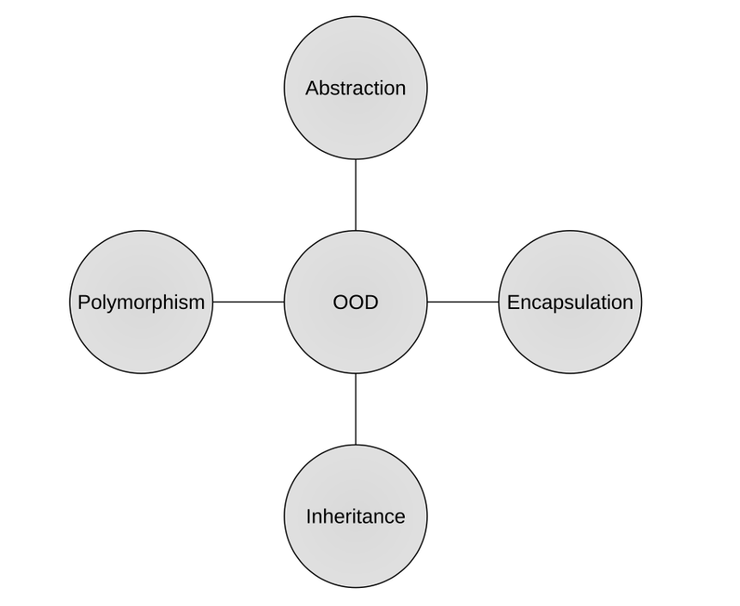
Basic concepts of OOD

Slide 4
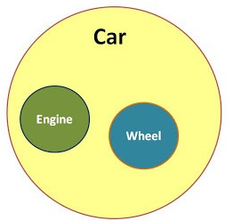
Abstraction
Notes:
class Employee {
private String name;
private int salary;
// Constructor
public Employee(String name, int salary) {
this.name = name;
this.salary = salary;
}
// Get the name of the employee
public String getName() {
return name;
}
// Set the name of the employee
public void setName(String name) {
this.name = name;
}
// Set salary with too much detail exposed (BAD ABSTRACTION)
public void setSalary(int salary, int taxPercentage, int bonus, int deductions) {
// Exposing too much complexity and calculation details
int netSalary = (salary + bonus) - deductions;
int taxedSalary = netSalary - (netSalary * taxPercentage / 100);
this.salary = taxedSalary;
}
// Get the salary of the employee
public int getSalary() {
return salary;
}
}
public class Main {
public static void main(String[] args) {
// Creating an employee
Employee emp = new Employee("John Doe", 5000);
// Setting salary with too many details (BAD ABSTRACTION)
emp.setSalary(5000, 20, 500, 100); // Needs to pass tax, bonus, and deductions manually
System.out.println("Employee Name: " + emp.getName());
System.out.println("Net Salary: " + emp.getSalary());
}
}
class Employee {
private String name;
private int salary;
// Constructor
public Employee(String name, int salary) {
this.name = name;
this.salary = salary;
}
// Get the name of the employee
public String getName() {
return name;
}
// Set only the base salary and abstract away other details (GOOD ABSTRACTION)
public void setSalary(int salary) {
int bonus = calculateBonus(salary);
int deductions = calculateDeductions(salary);
int tax = calculateTax(salary + bonus - deductions);
this.salary = salary + bonus - deductions - tax; // Final salary calculation
}
// Private methods abstract the internal calculation complexity (hidden from the user)
private int calculateBonus(int baseSalary) {
return baseSalary * 10 / 100; // Example bonus calculation (10% of base salary)
}
private int calculateDeductions(int baseSalary) {
return baseSalary * 5 / 100; // Example deductions (5% of base salary)
}
private int calculateTax(int netIncome) {
return netIncome * 20 / 100; // Example tax calculation (20% of net income)
}
// Get the salary of the employee
public int getSalary() {
return salary;
}
}
public class Main {
public static void main(String[] args) {
// Creating an employee
Employee emp = new Employee("John Doe", 5000);
// Setting salary with a clean and simple interface
emp.setSalary(5000); // User doesn't need to pass tax, bonus, or deductions manually
System.out.println("Employee Name: " + emp.getName());
System.out.println("Net Salary: " + emp.getSalary());
}
}

Slide 5
Abstraction
“A simplified description, or specification, of a system that emphasizes some of the system’s details or properties while suppressing others.”

Slide 6
Abstraction
Hiding the complex reality while exposing only the necessary parts of an object.
Helps in reducing programming complexity and increasing efficiency.

Slide 7
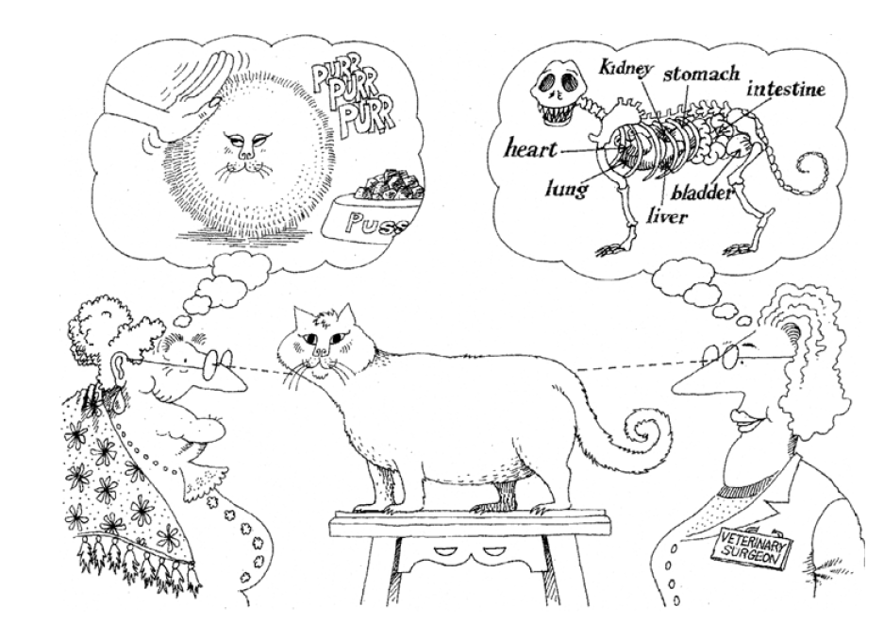
Abstraction

Slide 8
Abstraction
Hiding implementation is not just a matter of putting a layer of functions between the variables.

Slide 9
Abstraction
Class exposes abstract interfaces that allow its users to manipulate the essence of the data, without having to know its implementation.
Notes:
class Employee {
private String name;
private int salary;
// Constructor
public Employee(String name, int salary) {
this.name = name;
this.salary = salary;
}
// Get the name of the employee
public String getName() {
return name;
}
// Set the name of the employee
public void setName(String name) {
this.name = name;
}
// Set salary with too much detail exposed (BAD ABSTRACTION)
public void setSalary(int salary, int taxPercentage, int bonus, int deductions) {
// Exposing too much complexity and calculation details
int netSalary = (salary + bonus) - deductions;
int taxedSalary = netSalary - (netSalary * taxPercentage / 100);
this.salary = taxedSalary;
}
// Get the salary of the employee
public int getSalary() {
return salary;
}
}
public class Main {
public static void main(String[] args) {
// Creating an employee
Employee emp = new Employee("John Doe", 5000);
// Setting salary with too many details (BAD ABSTRACTION)
emp.setSalary(5000, 20, 500, 100); // Needs to pass tax, bonus, and deductions manually
System.out.println("Employee Name: " + emp.getName());
System.out.println("Net Salary: " + emp.getSalary());
}
}
class Employee {
private String name;
private int salary;
// Constructor
public Employee(String name, int salary) {
this.name = name;
this.salary = salary;
}
// Get the name of the employee
public String getName() {
return name;
}
// Set only the base salary and abstract away other details (GOOD ABSTRACTION)
public void setSalary(int salary) {
int bonus = calculateBonus(salary);
int deductions = calculateDeductions(salary);
int tax = calculateTax(salary + bonus - deductions);
this.salary = salary + bonus - deductions - tax; // Final salary calculation
}
// Private methods abstract the internal calculation complexity (hidden from the user)
private int calculateBonus(int baseSalary) {
return baseSalary * 10 / 100; // Example bonus calculation (10% of base salary)
}
private int calculateDeductions(int baseSalary) {
return baseSalary * 5 / 100; // Example deductions (5% of base salary)
}
private int calculateTax(int netIncome) {
return netIncome * 20 / 100; // Example tax calculation (20% of net income)
}
// Get the salary of the employee
public int getSalary() {
return salary;
}
}
public class Main {
public static void main(String[] args) {
// Creating an employee
Employee emp = new Employee("John Doe", 5000);
// Setting salary with a clean and simple interface
emp.setSalary(5000); // User doesn't need to pass tax, bonus, or deductions manually
System.out.println("Employee Name: " + emp.getName());
System.out.println("Net Salary: " + emp.getSalary());
}
}

Slide 10

Abstraction

Slide 11
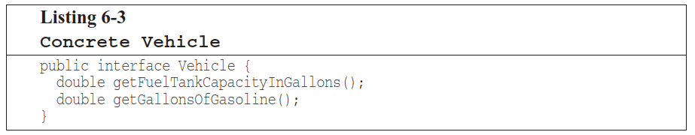
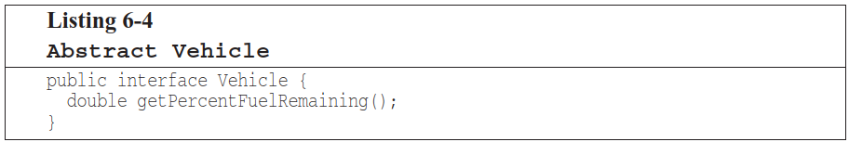
Abstraction
Better

Slide 12
OOP concepts: Encapsulation
Is a fundamental concept in OOP.
Combines data (attributes) and methods that work with that data into a single unit known as a class.

Slide 13
Encapsulation
Is a protective layer around the data maintains its integrity and prevents unauthorized access.

Slide 14
Encapsulation
Object
Programming
Interface
Attributes (data) typically private to this object
Methods (behaviors / procedures)
Other
objects

Slide 15
Encapsulation
Take data encapsulation to heart; severely limit the access of any data that may be shared.

Slide 16
Getter and Setter: Encapsulation
By using getters and setters, we encapsulate the internal state and protect it from direct access.
Modifications can only happen through a setter, where we can validate input.

Slide 17
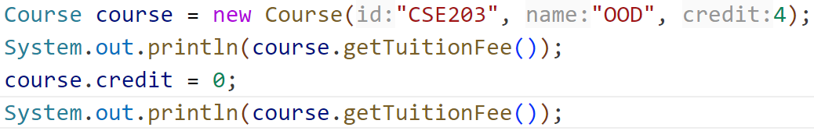
Getter and Setter: Encapsulation
x

Slide 18
Getter and Setter: Abstraction
Getters and setters abstract away the complexity of how the internal data is stored or validated.

Slide 19
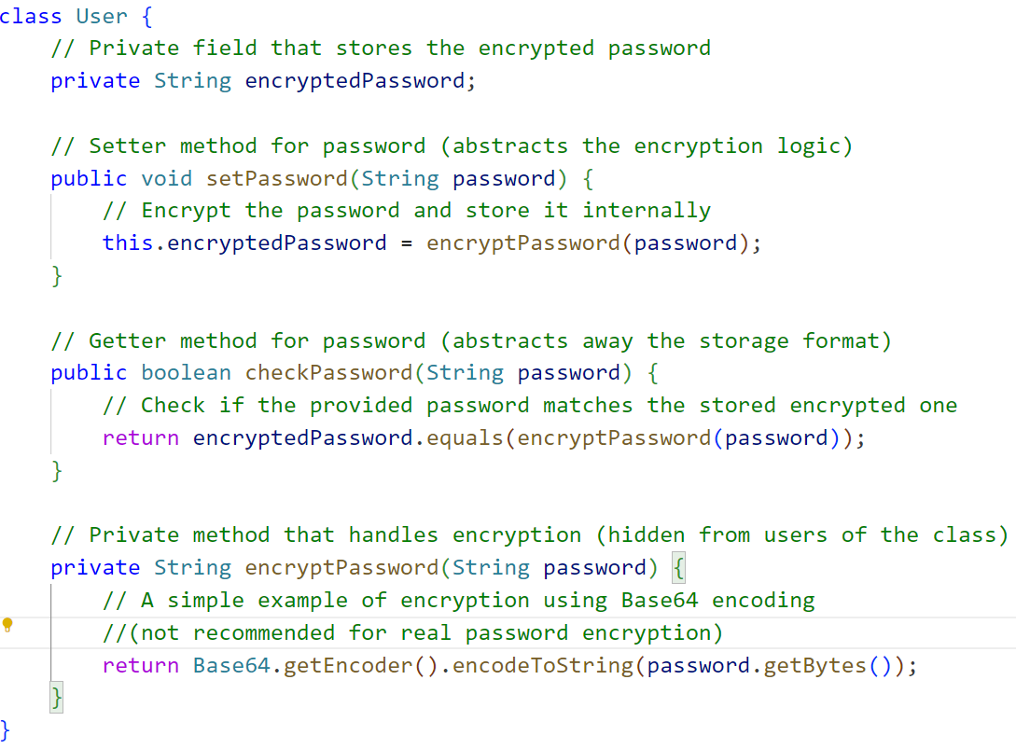

Slide 20
Inheritance
Insect
Contains those attributes and methods that are shared by all insects.
BumbleBee
Grasshopper
Contains those attributes and methods that specific to a Bumble Bee.
Contains those attributes and methods that are specific to a Grasshopper.

Slide 21
The “is a” Relationship (1 of 2)
The relationship between a superclass and an inherited class is called an “is a” relationship.
A grasshopper “is a” insect.
A poodle “is a” dog.
A car “is a” vehicle.
A specialized object has:
all of the characteristics of the general object, plus
additional characteristics that make it special.
In object-oriented programming, inheritance is used to create an “is a” relationship among classes.

Slide 22
The “is a” Relationship (2 of 2)
We can extend the capabilities of a class.
Inheritance involves a superclass and a subclass.
The superclass is the general class and
the subclass is the specialized class.
The subclass is based on, or extended from, the superclass.
Superclasses are also called base classes, and
subclasses are also called derived classes.
The relationship of classes can be thought of as parent classes and child classes.

Slide 23
Inheritance
The subclass inherits fields and methods from the superclass without any of them being rewritten.
New fields and methods may be added to the subclass.
The Java keyword, extends, is used on the class header to define the subclass.
public class FinalExam extends GradedActivity

Slide 24
The GradedActivity Example
GradedActivity
Contains those attributes and methods that are shared by all graded activities.
- score : double
+ setScore(s : double) : void
+ getScore() : double
+ getGrade() : char
Contains those attributes and methods that are specific to the FinalExam class.
Inherits all non-private attributes and methods from the GradedActivity class.
FinalExam
- numQuestions : int
- pointsEach : double
- numMissed : int
+ FinalExam(questions : int,
missed : int)
+ getPointsEach() : double
+ getNumMissed() : int

Slide 25
Inheritance, Fields and Methods (1 of 2)
Members of the superclass that are marked private:
are not inherited by the subclass,
exist in memory when the object of the subclass is created
may only be accessed from the subclass by public methods of the superclass.
Members of the superclass that are marked public:
are inherited by the subclass, and
may be directly accessed from the subclass.

Slide 26
Inheritance, Fields and Methods (2 of 2)
When an instance of the subclass is created, the non-private methods of the superclass are available through the subclass object.
FinalExam exam = new FinalExam();
exam.setScore(85.0);
System.out.println("Score = " + exam.getScore());
Non-private methods and fields of the superclass are available in the subclass.
setScore(newScore);

Slide 27
Inheritance and Constructors
Constructors are not inherited.
When a subclass is instantiated, the superclass default constructor is executed first.
Example:
SuperClass1.java
SubClass1.java
ConstructorDemo1.java

Slide 28
The Superclass’s Constructor
The super keyword refers to an object’s superclass.
The superclass constructor can be explicitly called from the subclass by using the super keyword.
Example:
SuperClass2.java, SubClass2.java, ConstructorDemo2.java
Rectangle.java, Cube.java, CubeDemo.java

Slide 29
Calling The Superclass Constructor
If a parameterized constructor is defined in the superclass,
the superclass must provide a no-arg constructor, or
subclasses must provide a constructor, and
subclasses must call a superclass constructor.
Calls to a superclass constructor must be the first java statement in the subclass constructors.

Slide 30
Overriding Superclass Methods (1 of 5)
A subclass may have a method with the same signature as a superclass method.
The subclass method overrides the superclass method.
This is known as method overriding.
Example:
GradedActivity.java, CurvedActivity.java, CurvedActivityDemo.java

Slide 31
Overriding Superclass Methods (2 of 5)
GradedActivity
- score : double
+ setScore(s : double) : void
+ getScore() : double
+ getGrade() : char
This method is a more specialized version of the setScore method in the superclass, GradedActivity.
CurvedActivity
- rawScore : double
- percentage : double
+ CurvedActivity
(percent : double)
+ setScore(s : double) : void
+ getRawScore() : double
+ getPercentage() : double

Slide 32
Overriding Superclass Methods (3 of 5)
Recall that a method’s signature consists of:
the method’s name
the data types method’s parameters in the order that they appear.
A subclass method that overrides a superclass method must have the same signature as the superclass method.
An object of the subclass invokes the subclass’s version of the method, not the superclass’s.
The @Override annotation should be used just before the subclass method declaration.
This causes the compiler to display a error message if the method fails to correctly override a method in the superclass.

Slide 33
Overriding Superclass Methods (4 of 5)
An subclass method can call the overridden superclass method via the super keyword.
super.setScore(rawScore * percentage);
There is a distinction between overloading a method and overriding a method.
Overloading is when a method has the same name as one or more other methods, but with a different signature.
When a method overrides another method, however, they both have the same signature.

Slide 34
Overriding Superclass Methods (5 of 5)
Both overloading and overriding can take place in an inheritance relationship.
Overriding can only take place in an inheritance relationship.
Example:
SuperClass3.java,
SubClass3.java,
ShowValueDemo.java

Slide 35
Preventing a Method from Being Overridden
The final modifier will prevent the overriding of a superclass method in a subclass.
public final void message()
If a subclass attempts to override a final method, the compiler generates an error.
This ensures that a particular superclass method is used by subclasses rather than a modified version of it.

Slide 36
Protected Members (1 of 2)
Protected members of class:
may be accessed by methods in a subclass, and
by methods in the same package as the class.
Java provides a third access specification, protected.
A protected member’s access is somewhere between private and public.
Example:
GradedActivity2.java
FinalExam2.java
ProtectedDemo.java

Slide 37
Protected Members (2 of 2)
Using protected instead of private makes some tasks easier.
However, any class that is derived from the class, or is in the same package, has unrestricted access to the protected member.
It is always better to make all fields private and then provide public methods for accessing those fields.
If no access specifier for a class member is provided, the class member is given package access by default.
Any method in the same package may access the member.

Slide 38
Access Specifiers
Access Modifier | Accessible to a subclass inside the same package? | Accessible to all other classes inside the same package?
default (no modifier) | Yes | Yes
Public | Yes | Yes
Protected | Yes | Yes
Private | No | No
Access Modifier | Accessible to a subclass outside the package? | Accessible to all other classes outside the package?
default (no modifier) | No | No
Public | Yes | Yes
Protected | Yes | No
Private | No | No

Slide 39
Chains of Inheritance (1 of 2)
A superclass can also be derived from another class.
Object
Example: GradedActivity.java PassFailActivity.java PassFailExam.java PassFailExamDemo.java
GradedActivity
PassFailActivity
PassFailExam

Slide 40
Chains of Inheritance (2 of 2)
Classes often are depicted graphically in a class hierarchy.
A class hierarchy shows the inheritance relationships between classes.
GradedActivity
FinalExam
PassFailActivity
PassFailExam

Slide 41
The Object Class (1 of 2)
All Java classes are directly or indirectly derived from a class named Object.
Object is in the java.lang package.
Any class that does not specify the extends keyword is automatically derived from the Object class.
public class MyClass
{
// This class is derived from Object.
}
Ultimately, every class is derived from the Object class.

Slide 42
The Object Class (2 of 2)
Because every class is directly or indirectly derived from the Object class:
every class inherits the Object class’s members.
example: toString and equals.
In the Object class, the toString method returns a string containing the object’s class name and a hash of its memory address.
The equals method accepts the address of an object as its argument and returns true if it is the same as the calling object’s address.
Example: ObjectMethods.java

Slide 43
Polymorphism (1 of 4)
A reference variable can reference objects of classes that are derived from the variable’s class.
GradedActivity exam;
We can use the exam variable to reference a GradedActivity object.
exam = new GradedActivity();
The GradedActivity class is also used as the superclass for the FinalExam class.
An object of the FinalExam class is a GradedActivity object.

Slide 44
Polymorphism (2 of 4)
A GradedActivity variable can be used to reference a FinalExam object.
GradedActivity exam = new FinalExam(50, 7);
This statement creates a FinalExam object and stores the object’s address in the exam variable.
This is an example of polymorphism.
The term polymorphism means the ability to take many forms.
In Java, a reference variable is polymorphic because it can reference objects of types different from its own, as long as those types are subclasses of its type.

Slide 45
Polymorphism (3 of 4)
Other legal polymorphic references:
GradedActivity exam1 = new FinalExam(50, 7);
GradedActivity exam2 = new PassFailActivity(70);
GradedActivity exam3 = new PassFailExam(100, 10, 70);
The GradedActivity class has three methods: setScore, getScore, and getGrade.
A GradedActivity variable can be used to call only those three methods.
GradedActivity exam = new PassFailExam(100, 10, 70);
System.out.println(exam.getScore()); // This works.
System.out.println(exam.getGrade()); // This works.
System.out.println(exam.getPointsEach()); // ERROR!

Slide 46
Polymorphism and Dynamic Binding
If the object of the subclass has overridden a method in the superclass:
If the variable makes a call to that method the subclass’s version of the method will be run.
GradedActivity exam = new PassFailActivity(60);
exam.setScore(70);
System.out.println(exam.getGrade());
Java performs dynamic binding or late binding when a variable contains a polymorphic reference.
The Java Virtual Machine determines at runtime which method to call, depending on the type of object that the variable references.

Slide 47
Polymorphism (4 of 4)
It is the object’s type, rather than the reference type, that determines which method is called.
Example:
Polymorphic.java
You cannot assign a superclass object to a subclass reference variable.

Slide 48
Abstract Classes
An abstract class cannot be instantiated, but other classes are derived from it.
An Abstract class serves as a superclass for other classes.
The abstract class represents the generic or abstract form of all the classes that are derived from it.
A class becomes abstract when you place the abstract key word in the class definition.
public abstract class ClassName

Slide 49
Abstract Methods (1 of 2)
An abstract method has no body and must be overridden in a subclass.
An abstract method is a method that appears in a superclass, but expects to be overridden in a subclass.
An abstract method has only a header and no body.
AccessSpecifier abstract ReturnType MethodName(ParameterList);
Example:
Student.java, CompSciStudent.java, CompSciStudentDemo.java

Slide 50
Abstract Methods (2 of 2)
Notice that the key word abstract appears in the header, and that the header ends with a semicolon.
public abstract void setValue(int value);
Any class that contains an abstract method is automatically abstract.
If a subclass fails to override an abstract method, a compiler error will result.
Abstract methods are used to ensure that a subclass implements the method.

Slide 51
Interfaces (1 of 3)
An interface is similar to an abstract class that has all abstract methods.
It cannot be instantiated, and
all of the methods listed in an interface must be written elsewhere.
The purpose of an interface is to specify behavior for other classes.
It is often said that an interface is like a “contract,” and when a class implements an interface it must adhere to the contract.
An interface looks similar to a class, except:
the keyword interface is used instead of the keyword class, and
the methods that are specified in an interface have no bodies, only headers that are terminated by semicolons.

Slide 52
Interfaces (2 of 3)
The general format of an interface definition:
public interface InterfaceName
{
(Method headers...)
}
All methods specified by an interface are public by default.
A class can implement one or more interfaces.

Slide 53
Interfaces (3 of 3)
If a class implements an interface, it uses the implements keyword in the class header.
public class FinalExam3 extends GradedActivity implements Relatable
Example:
GradedActivity.java
Relatable.java
FinalExam3.java
InterfaceDemo.java

Slide 54
Fields in Interfaces
An interface can contain field declarations:
all fields in an interface are treated as final and static.
Because they automatically become final, you must provide an initialization value.
public interface Doable
{
int FIELD1 = 1, FIELD2 = 2;
(Method headers...)
}
In this interface, FIELD1 and FIELD2 are final static int variables.
Any class that implements this interface has access to these variables.

Slide 55
Implementing Multiple Interfaces
A class can be derived from only one superclass.
Java allows a class to implement multiple interfaces.
When a class implements multiple interfaces, it must provide the methods specified by all of them.
To specify multiple interfaces in a class definition, simply list the names of the interfaces, separated by commas, after the implements key word.
public class MyClass implements Interface1,
Interface2,
Interface3

Slide 56
Interfaces in UML
GradedActivity
A dashed line with an arrow indicates implementation of an interface.
FinalExam3
Relatable

Slide 57
Polymorphism with Interfaces (1 of 3)
Java allows you to create reference variables of an interface type.
An interface reference variable can reference any object that implements that interface, regardless of its class type.
This is another example of polymorphism.
Example:
RetailItem.java
CompactDisc.java
DvdMovie.java
PolymorphicInterfaceDemo.java

Slide 58
Polymorphism with Interfaces (2 of 3)
In the example code, two RetailItem reference variables, item1 and item2, are declared.
The item1 variable references a CompactDisc object and the item2 variable references a DvdMovie object.
When a class implements an interface, an inheritance relationship known as interface inheritance is established.
a CompactDisc object is a RetailItem, and
a DvdMovie object is a RetailItem.

Slide 59
Polymorphism with Interfaces (3 of 3)
A reference to an interface can point to any class that implements that interface.
You cannot create an instance of an interface.
RetailItem item = new RetailItem(); // ERROR!
When an interface variable references an object:
only the methods declared in the interface are available,
explicit type casting is required to access the other methods of an object referenced by an interface reference.

Slide 60
Default Methods
Beginning in Java 8, interfaces may have default methods.
A default method is an interface method that has a body.
You can add new methods to an existing interface without causing errors in the classes that already implement the interface.
Example:
Displayable.java
Person.java
InterfaceDemoDefaultMethod.java

Slide 61
Anonymous Inner Classes
An inner class is a class that is defined inside another class.
An anonymous inner class is an inner class that has no name.
An anonymous inner class must implement an interface, or extend another class.
Useful when you need a class that is simple, and to be instantiated only once in your code.
Example:
IntCalculator.java
AnonymousClassDemo.java

Slide 62
Functional Interfaces and Lambda Expressions
A functional interface is an interface that has one abstract method.
A lambda expression can be used to create an object that implements the interface, and overrides its abstract method.
In Java 8, these features work together to simplify code, particularly in situations where you might use anonymous inner classes.
Example:
LambdaDemo.java
LambdaDemo2.java

